Slide 1
Introduction to Molecular Dynamics
SHUG-2015
Jose M. Borreguero
Neutron Data Analysis and Visualization Division
Center for Accelerating Materials Modelling

Slide 2
Outline
Minimal requirements
Ab initio MD
Formal derivation of the Force-Field from Ab Initio MD expressions

Slide 3

Minimal Requirements to Run a Simulation
A Hamiltonian (Force-Field)
An environment for the system
Heat bath
Pressure bath
Boundary conditions
A starting conformation for every particle in the system:
Coordinates
Velocities
A solver of Newton’s equations for the system
Specify which quantities to compute
Time-evolution of coordinates
Thermodynamic quantities (T, P, V, density)
Evaluation of the potential terms

Slide 4
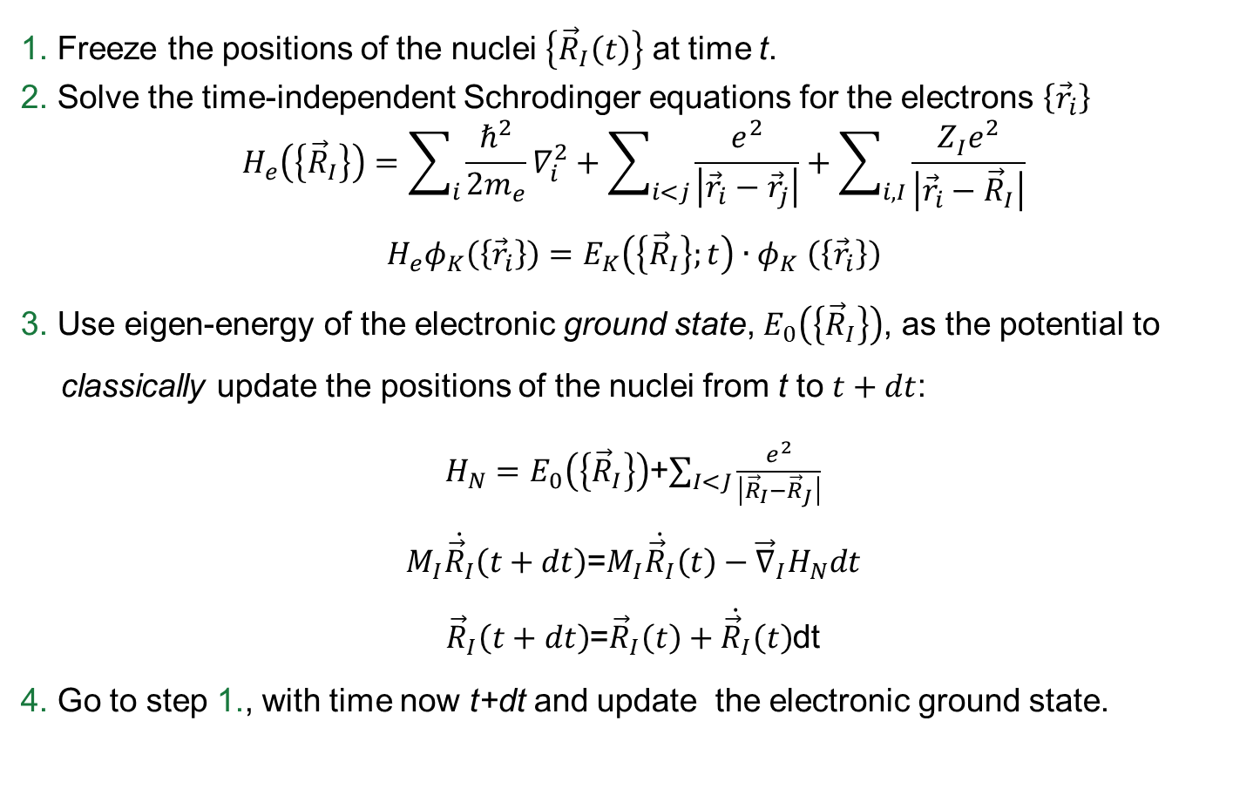
MD in the Born-Oppenheimer approx.
1. Freeze the positions of the nuclei $\left\{{\vec{R}}_{I}\left(t\right)\right\}$ at time t.
2. Solve the time-independent Schrodinger equations for the electrons $\left\{{\vec{r}}_{i}\right\}$
$$H_{e}\left(\left\{{\vec{R}}_{I}\right\}\right)=\sum_{i}{\frac{ℏ^{2}}{2m_{e}}∇_{i}^{2}}+\sum_{i<j}{\frac{e^{2}}{\left|{\vec{r}}_{i}−{\vec{r}}_{j}\right|}}+\sum_{i,I}{\frac{{Z_{I}^{}e}^{2}}{\left|{\vec{r}}_{i}−{\vec{R}}_{I}\right|}}$$
$$H_{e}φ_{K}\left(\left\{{\vec{r}}_{i}\right\}\right)=E_{K}\left(\left\{{\vec{R}}_{I}\right\};t\right){∙φ}_{K}\left(\left\{{\vec{r}}_{i}\right\}\right)$$
3. Use eigen-energy of the electronic ground state, $E_{0}\left(\left\{{\vec{R}}_{I}\right\}\right)$, as the potential to classically update the positions of the nuclei from t to $t+dt$:
$H_{N}=E_{0}\left(\left\{{\vec{R}}_{I}\right\}\right)$+$\sum_{I<J}{\frac{e^{2}}{\left|{\vec{R}}_{I}−{\vec{R}}_{J}\right|}}$
$M_{I}\dot{{\vec{R}}_{I}}\left(t+dt\right)$=$M_{I}\dot{{\vec{R}}_{I}}\left(t\right)−{\vec{∇}}_{I}H_{N}dt$
${\vec{R}}_{I}\left(t+dt\right)$=${\vec{R}}_{I}\left(t\right)+\dot{{\vec{R}}_{I}}\left(t\right)$dt
4. Go to step 1., with time now t+dt and update the electronic ground state.

Slide 5
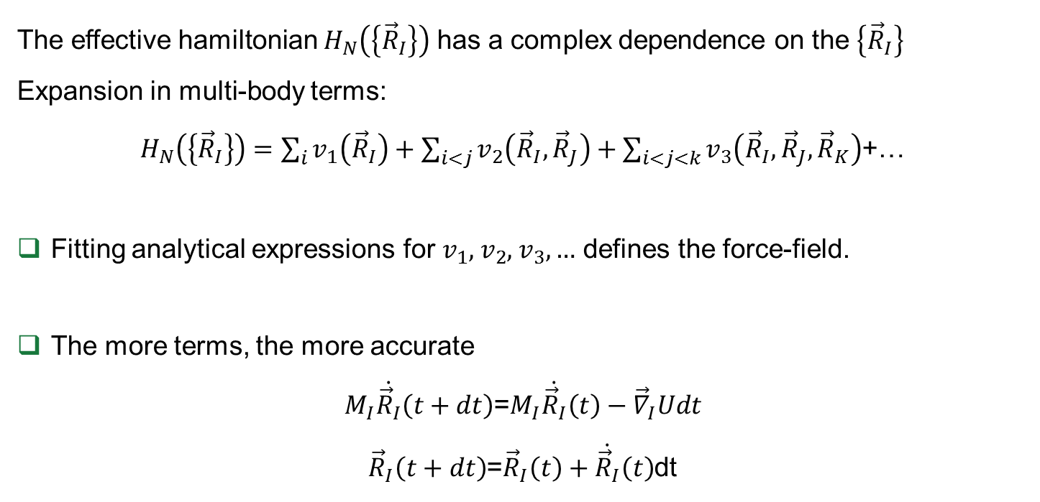
MD Force-Field (FF)
The effective hamiltonian $H_{N}\left(\left\{{\vec{R}}_{I}\right\}\right)$ has a complex dependence on the $\left\{{\vec{R}}_{I}\right\}$
Expansion in multi-body terms:
$H_{N}\left(\left\{{\vec{R}}_{I}\right\}\right)=\sum_{i}{v_{1}\left({\vec{R}}_{I}\right)}+\sum_{i<j}{v_{2}\left({\vec{R}}_{I},{\vec{R}}_{J}\right)}+\sum_{i<j<k}{v_{3}\left({\vec{R}}_{I},{\vec{R}}_{J},{\vec{R}}_{K}\right)}$+…
Fitting analytical expressions for $v_{1}$, $v_{2}$, $v_{3},…$ defines the force-field.
The more terms, the more accurate
$M_{I}\dot{{\vec{R}}_{I}}\left(t+dt\right)$=$M_{I}\dot{{\vec{R}}_{I}}\left(t\right)−{\vec{∇}}_{I}Udt$
${\vec{R}}_{I}\left(t+dt\right)$=${\vec{R}}_{I}\left(t\right)+\dot{{\vec{R}}_{I}}\left(t\right)$dt
A Force-Field bypasses calculation of the electronic ground state at each time step!

